Slide 1
MEDICA
JHHUKJILK

Slide 2
Why MEDICA?
Well a lot of the time, people have often found themselves in situations where they have either lost or misplaced their prescription while they are still on the prescribed medication(s).
Worry no more, cause this app will take care of all it.

Slide 3
Medica is a one stop app, where the user after scanning and uploading their prescriptions, will be able to access it at anytime and all of this information is stored in an organised manner.
Also the app keeps a track of the number of appointments for their own reference and dates for the future appointments.
Medica also provides detail description of the medications present in the prescriptions.

Slide 4
BENEFITS
01
Organization
02
Tracking
Eliminating the possibility of misplacement and loss of prescription
03
04
Personal assistant
Scans and saves prescriptions.
Helps keep track of medicine intake.
Reminders for future appointments.

Slide 5
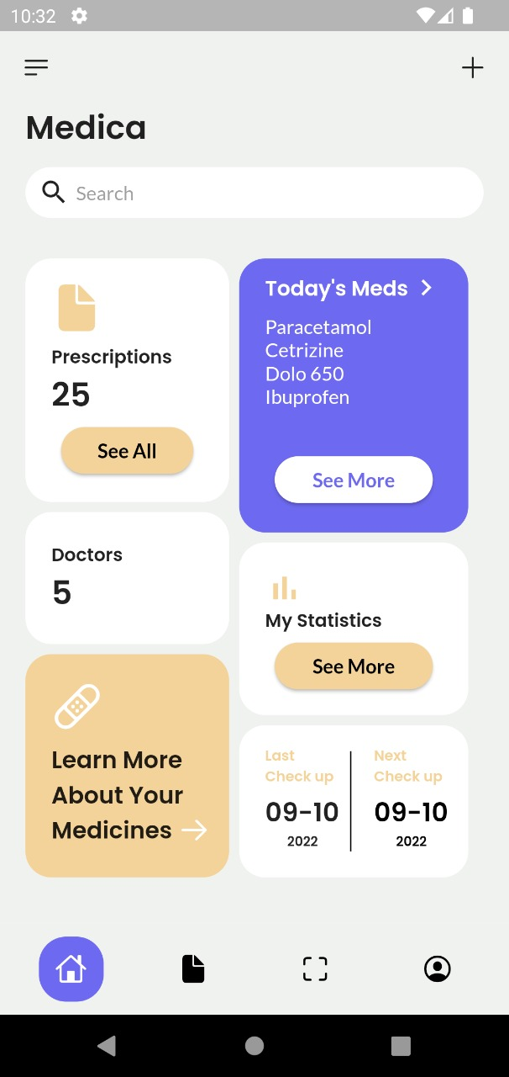
Home page
The home page consists of 6 interface elements:
The number and information of all the scanned and uploaded prescriptions.
The number of doctors a person currently sees or has previously consulted.
A blog which consists of all the information related to your prescribed medicines.
A tracker for the intake of your pills for the present day
A monthly statical analysis of one’s medicine intake.
A reminder for one’s next appointment

Slide 6
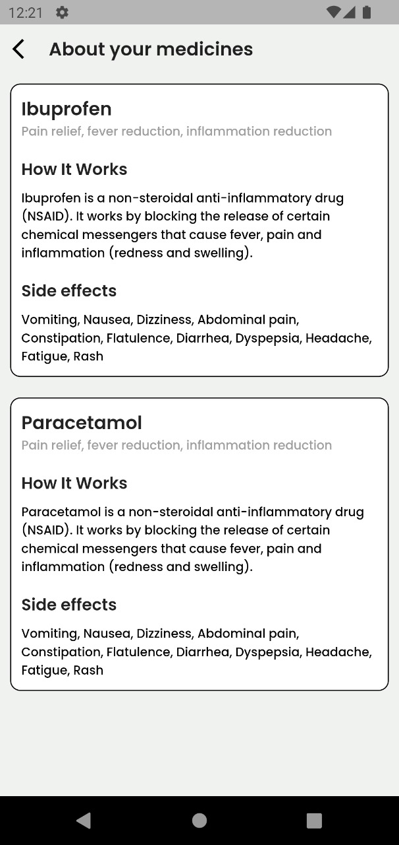
About your Medicines
The user can learn about the medicines prescribed to them by clicking on the lower left element present in the home page

Slide 7
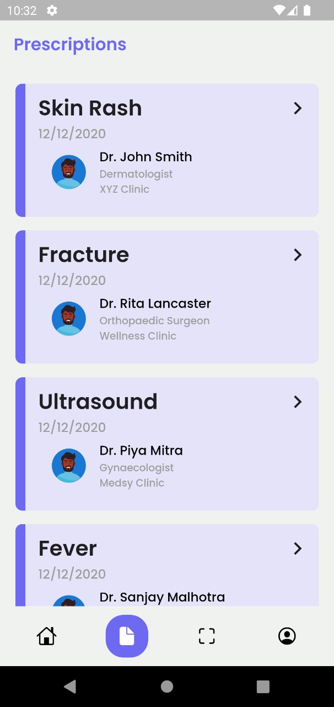
Prescriptions
The user will find all their scanned documents here.
The data from all the prescriptions will be extracted and will be categorized.
Under each section the cause of the problem or disease will be mentioned along with the prescribed medicines.
Each prescription will contain the doctor’s name along with their address and also the date of consultation.

Slide 8
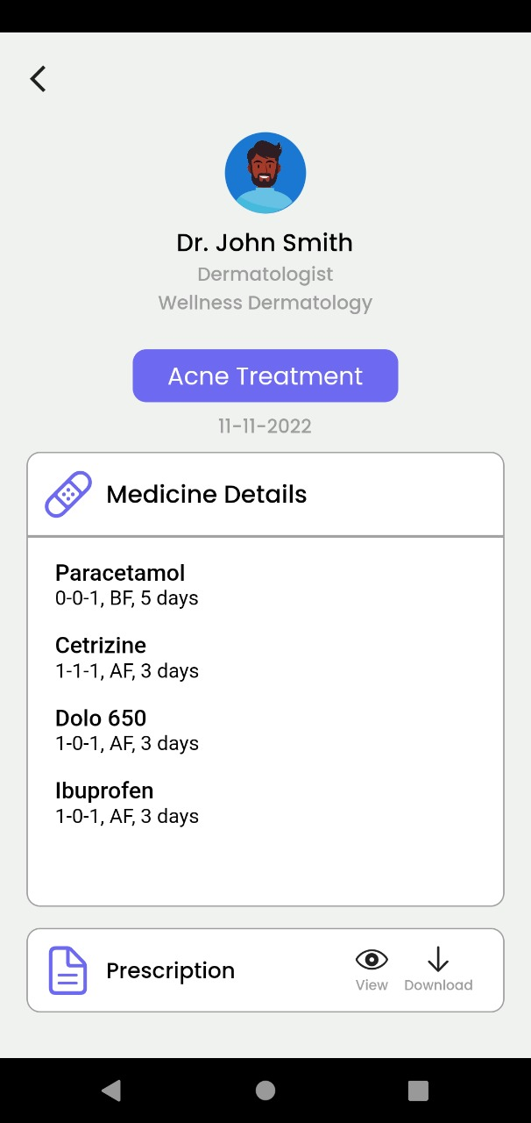
Prescription Details
The user can view the details of the prescription by clicking on the desired one.
Along with the reason for visit and the date of the visit.
In the prescription details the name of the doctor, the price of the consultation for the doctor will be displayed.
Lastly it will also contain the prescribed meds along with the intake and timing information.

Slide 9
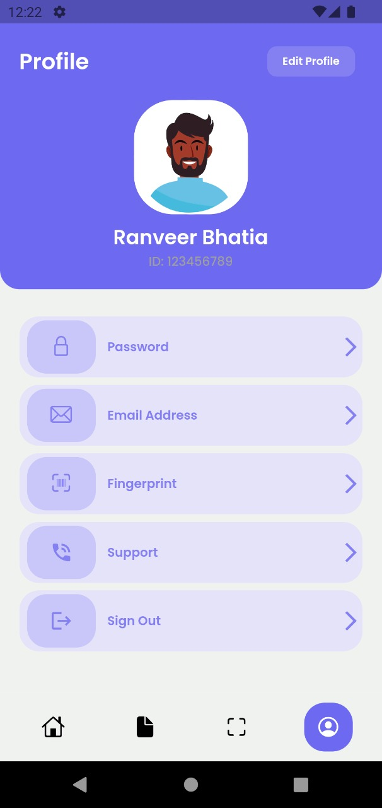
Profile
Once the user is logged in and has created a profile, this page will consist of the user’s personal details such as:
The name and phone number of the user.
The password, email address and fingerprint of the user.
It also has a support column for better UI experience.
And lastly a sign out option.

Slide 10
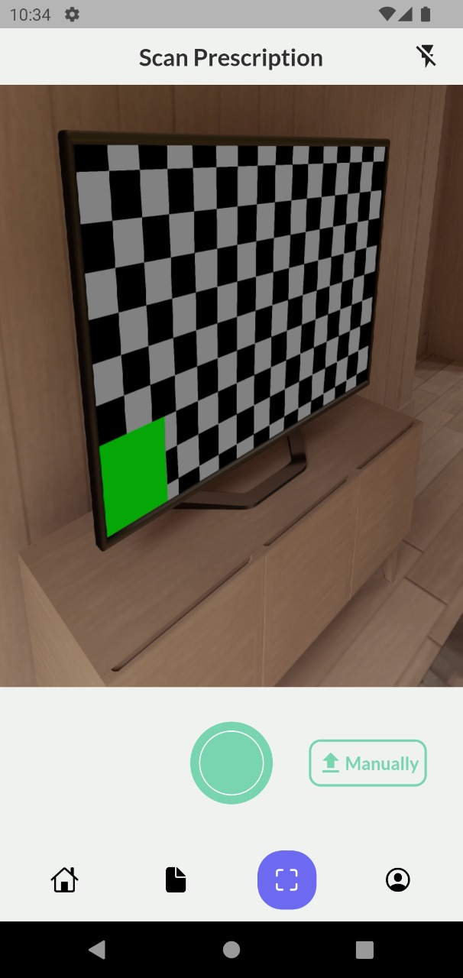
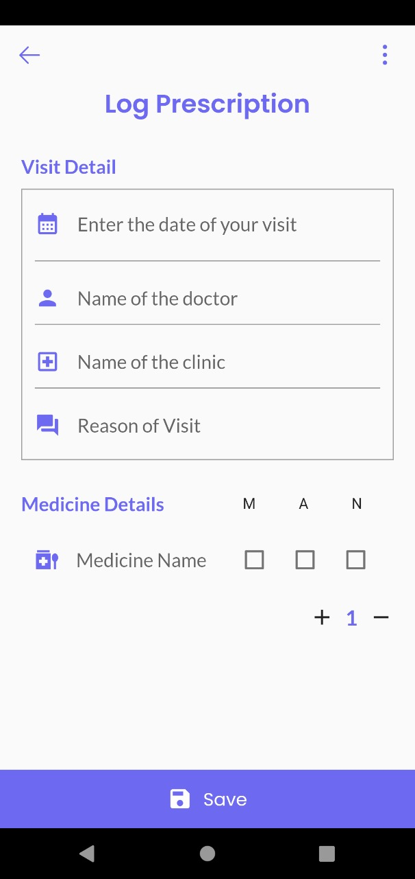
Scanner
This page will allow the user to upload their prescriptions manually or through the scanner.
To enter manually the user will be required to click on the ‘Manually’ button present on the lower ride side of the screen.
And these prescriptions will be stored in the database.
In the future we will add AI implementation in the scanner to assist the app in easily scanning specific medications

Slide 11
Framework Used
Flutter which is an open-source UI software development kit created by Google. It is used to develop cross-platform applications for Android, iOS, Linux, macOS, Windows, Google Fuchsia, and the web from a single codebase.
Dart which is a programming language designed for client development, such as for the web and mobile apps. It is developed by Google and can also be used to build server and desktop applications. It is an object-oriented, class-based, garbage-collected language with C-style syntax.

Slide 12
Future Enhancement
Integration with doctor
Reduced consultation fee
Buying prescriptions online
AI trained OCR scanner

Slide 13
Revenue Model
Sponsorship from pharmaceutical companies
Collaborating with Doctors
Collaboration with medical stores

Slide 14
¡THANK YOUU!
BY
Gayathri Valiveti: 1NH20CS077
Saifuddin Hisham K M: 1NH20CS192
Jumainah Khan: 1NH20CS100
Yukthaa A Shreeniwas: 1NH20IS187

